Slide 2
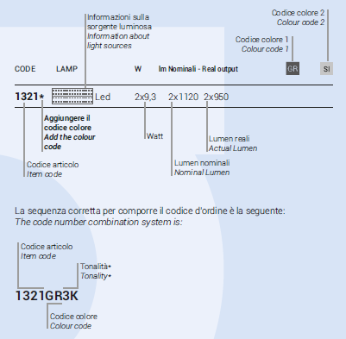
CODE NUMBER COMBINATION

Slide 3
LUNETTE
D235
LED 15W
230V – IP65 – CL I
D365
LED 30W
230V – IP65 – CL I

Slide 4
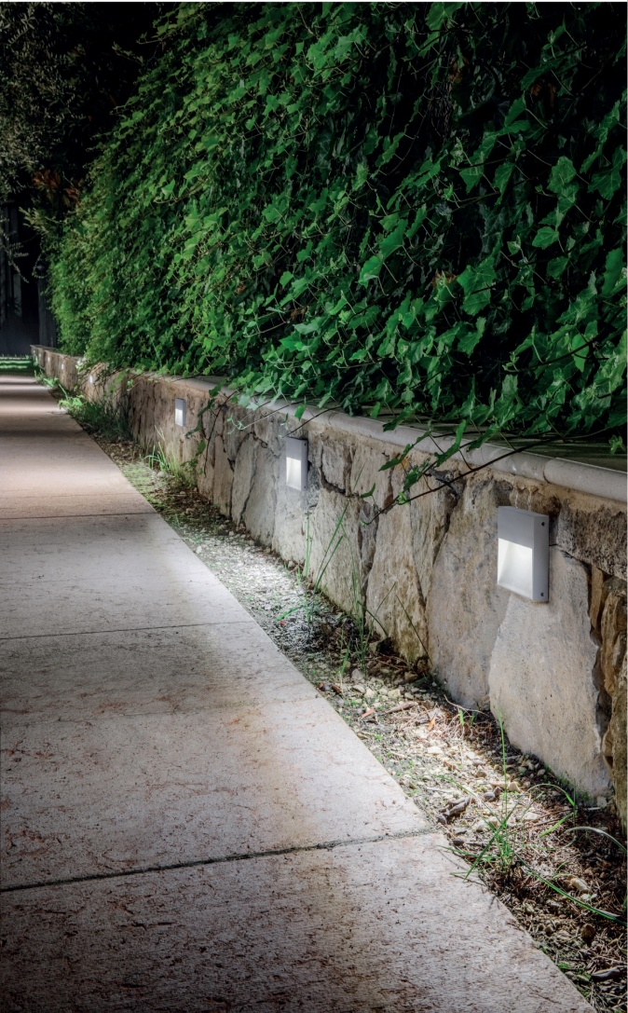
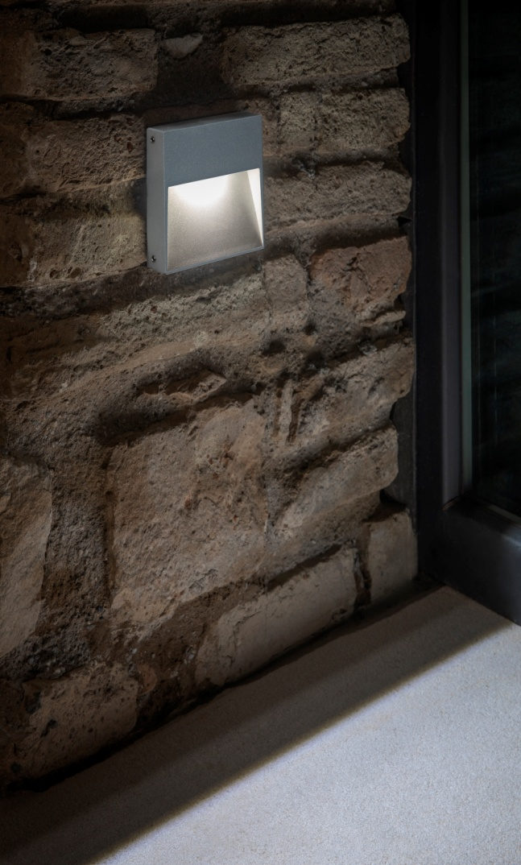
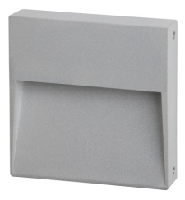
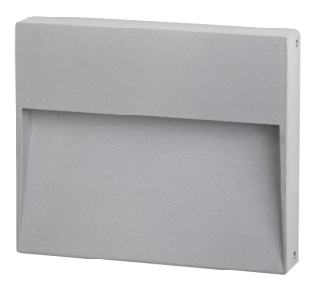
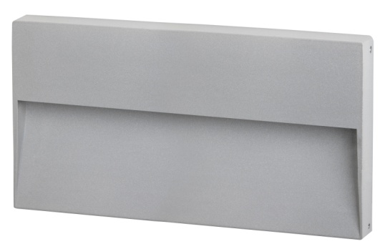
STAMP

Slide 5
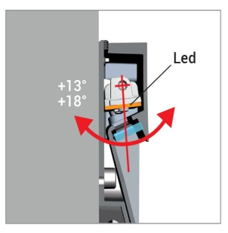
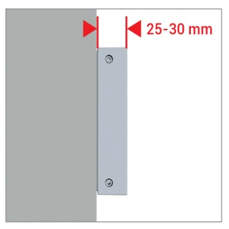
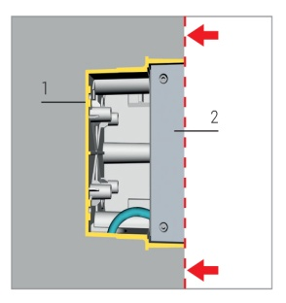
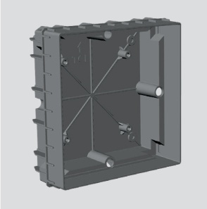
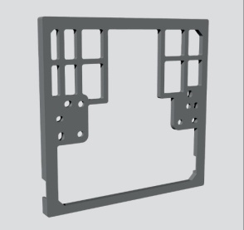
STAMP : technical data
ADJUSTABLE OPTIC
SURFACE/RECESSED
ACCESSORY:
SIDE CABLE ENTRY

Slide 6
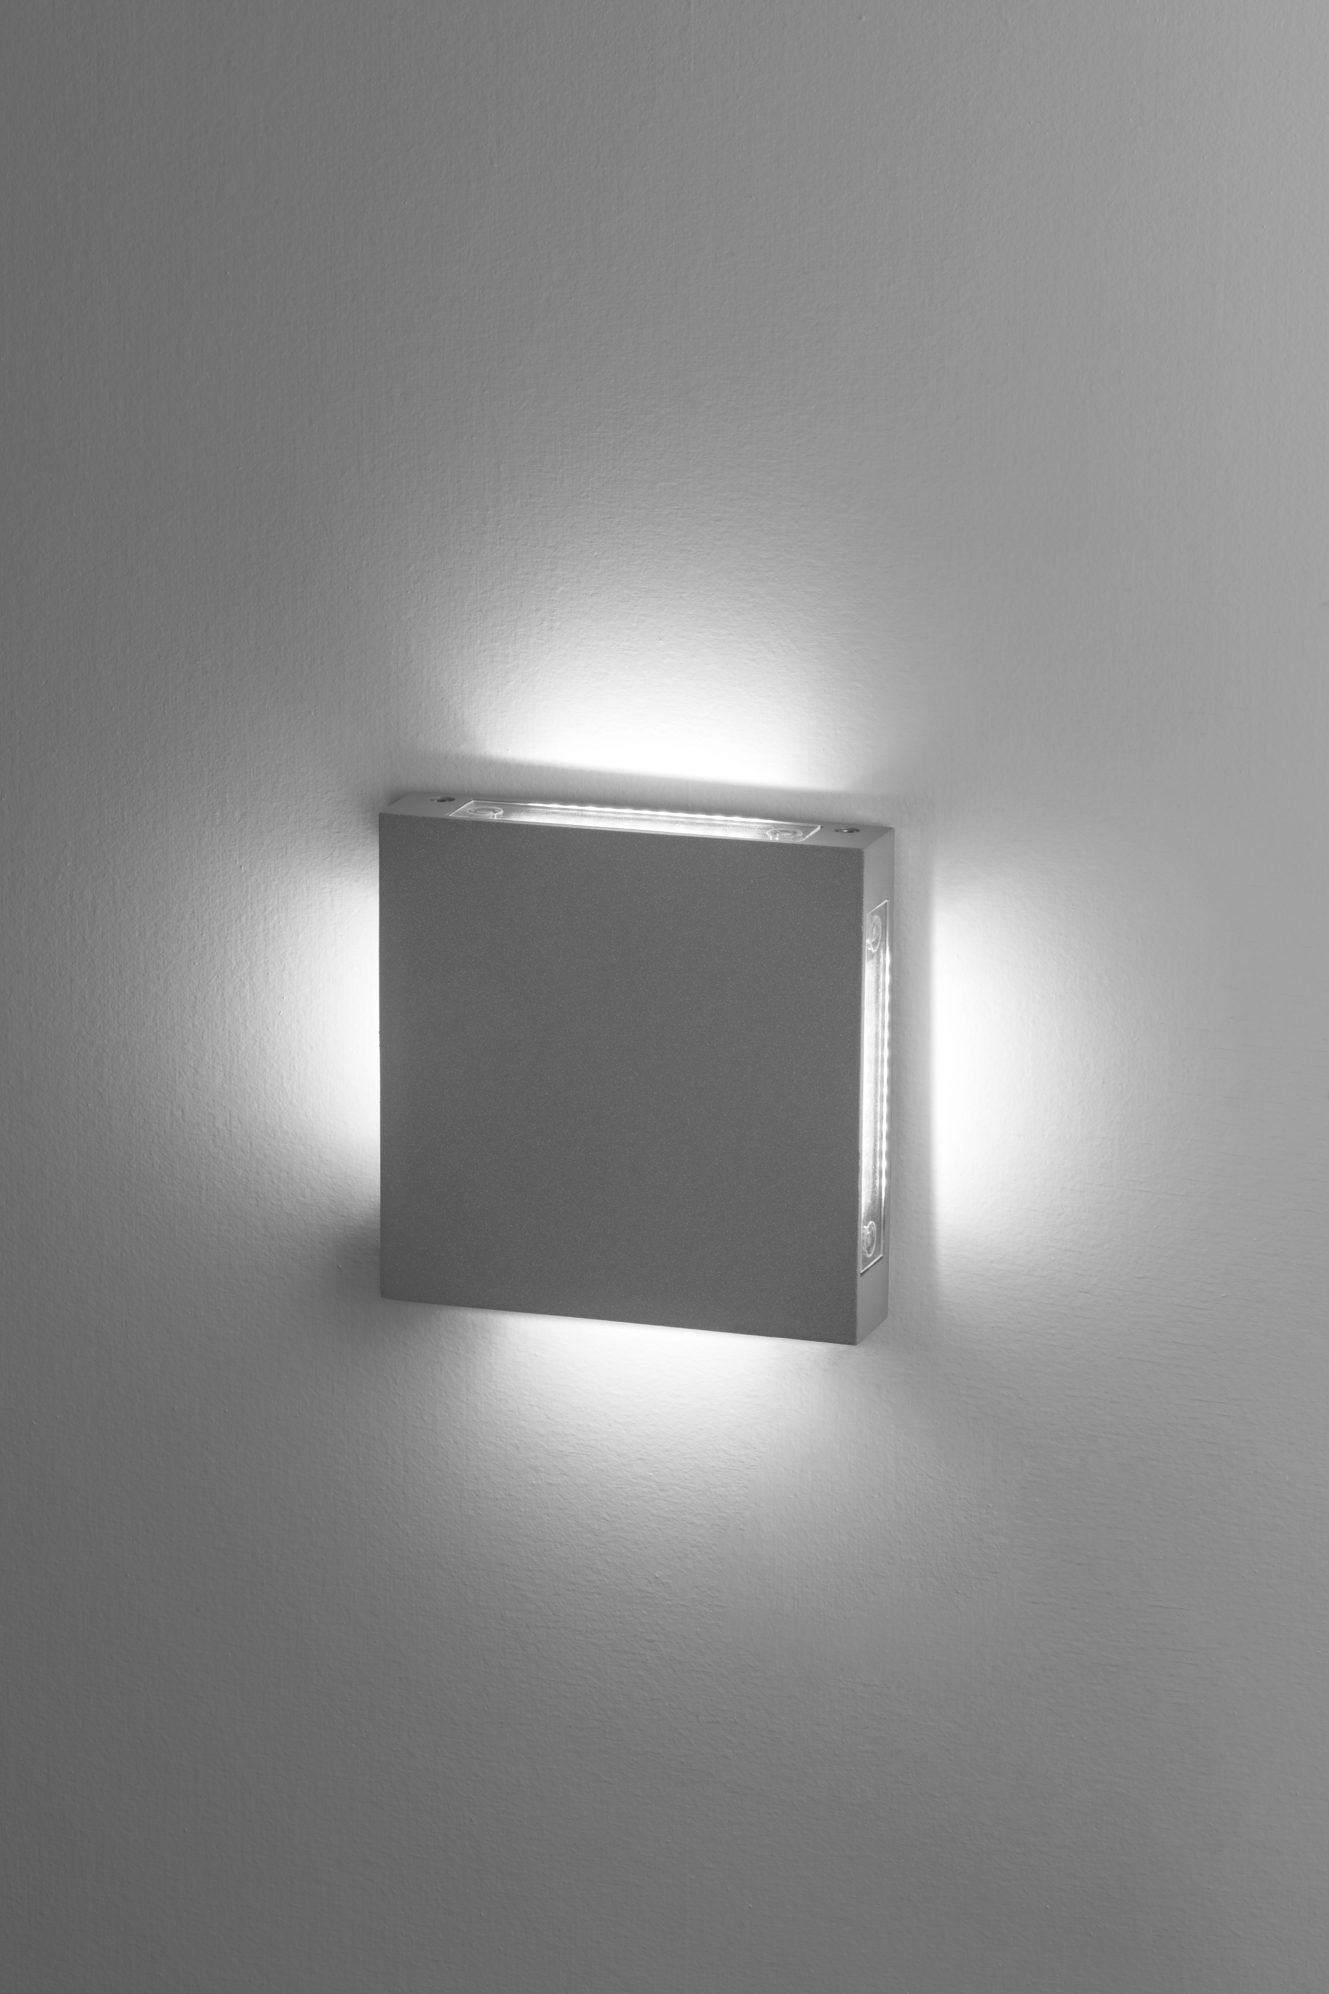
STAMP Side light - STAMP opal glass
STAMP Side Light
D120 x120
LED 3W LM 330/180
LED 2X3W LM 660/360
LED 4X3W LM 1320/720
STAMP Opal glass
D110x110
LED 6W LM 536/229
IP65 - CL III - 24V DC

Slide 7
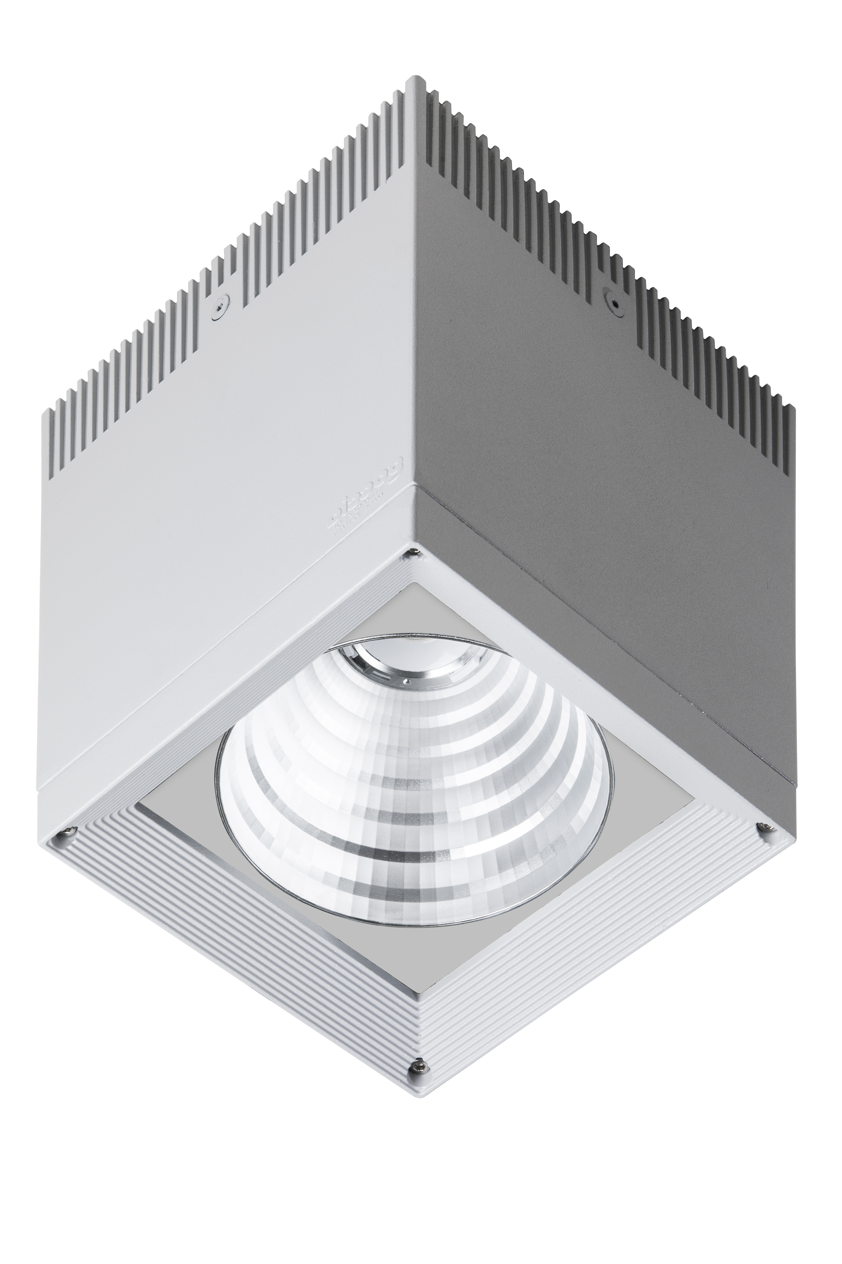
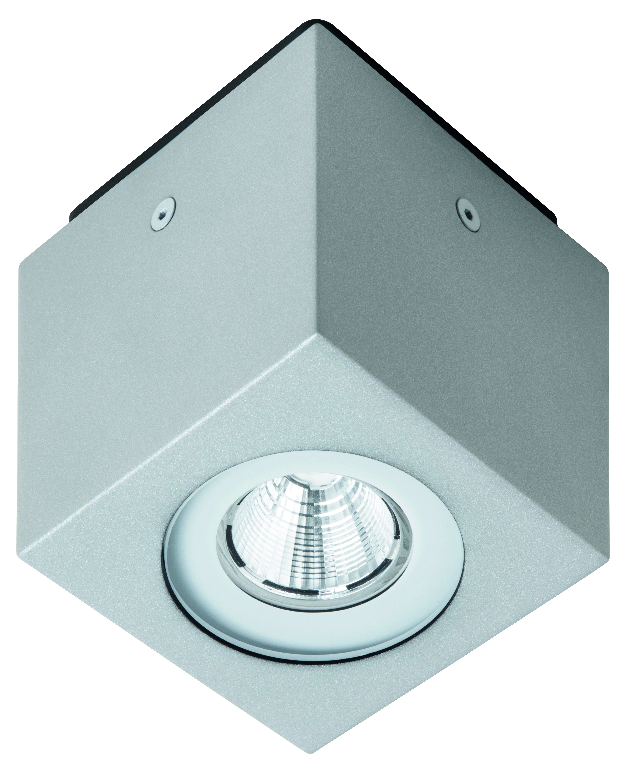
LUX SHOWER
LUX SHOWER 30
LED 10W
LM 1000/750
LUX SHOWER 100
LED 15W
LM 1425/950
LUX SHOWER 200
LED 23,5W
LM 2800/2350

Slide 8
LUX SHOWER 30
LUX SHOWER 30
LED 10W
IP 65 – 230V
DIMENSIONS 110X110
Beam angles: 12°- 40°- 90°
120° opal version available

Slide 9
CLOCK

Slide 10
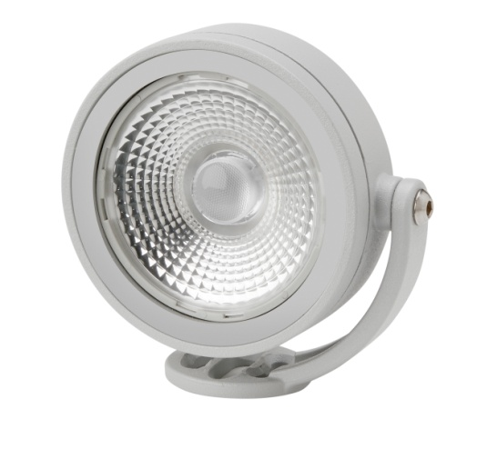
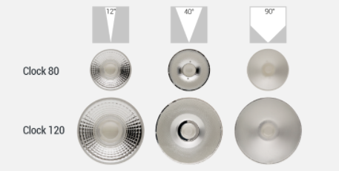
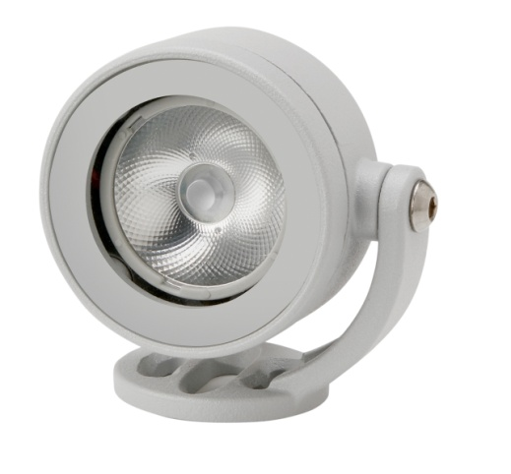
CLOCK

Slide 11
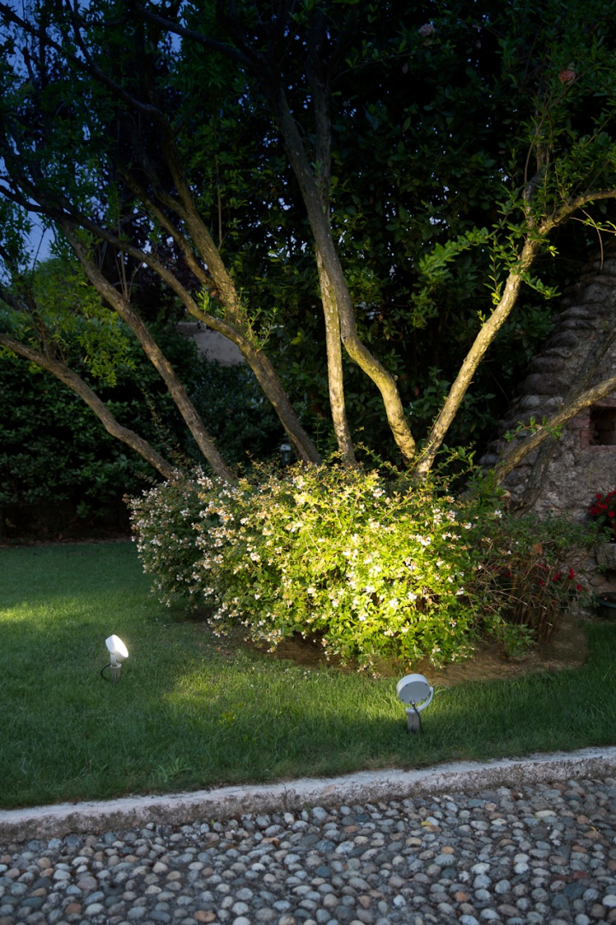
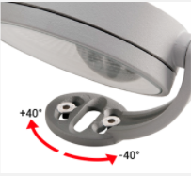
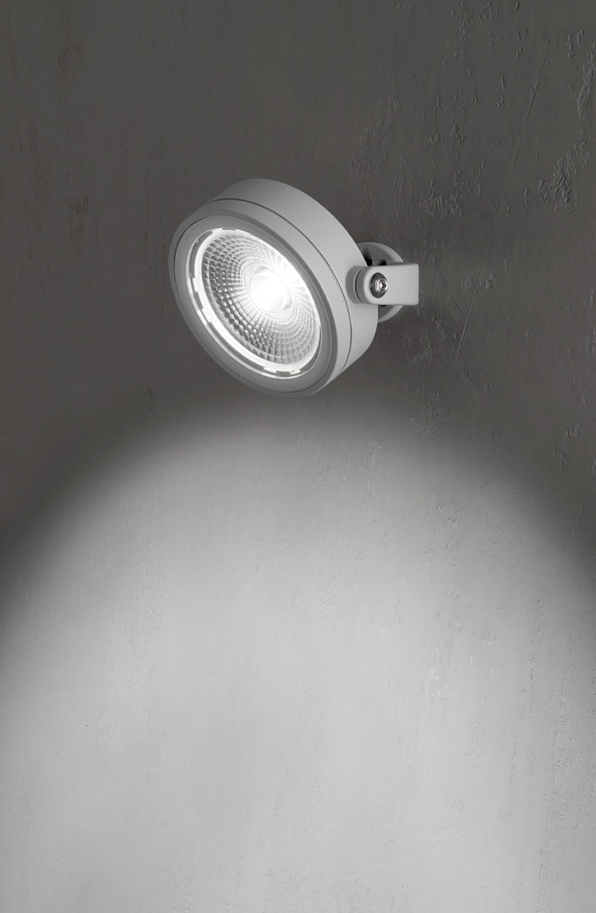
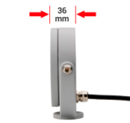
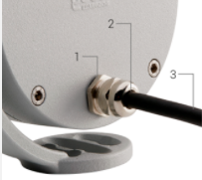
CLOCK

Slide 12
CANTHARELLUS

Slide 13
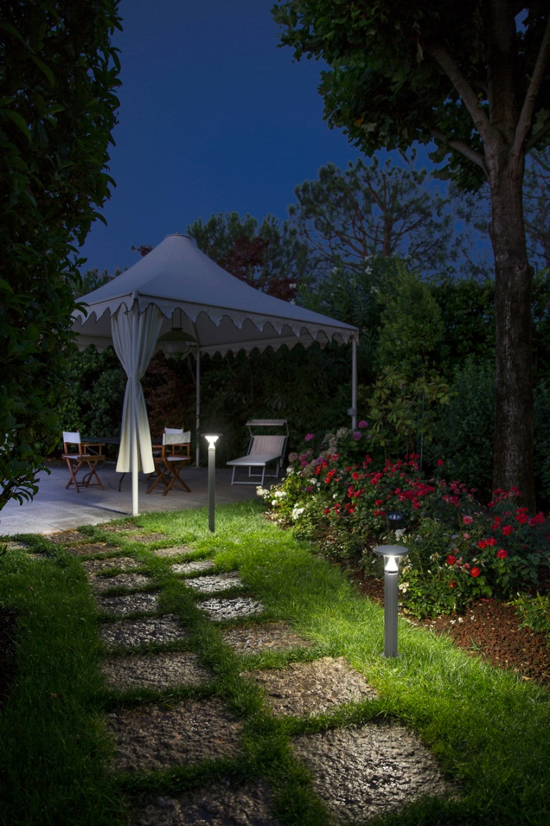
CANTHARELLUS

Slide 14
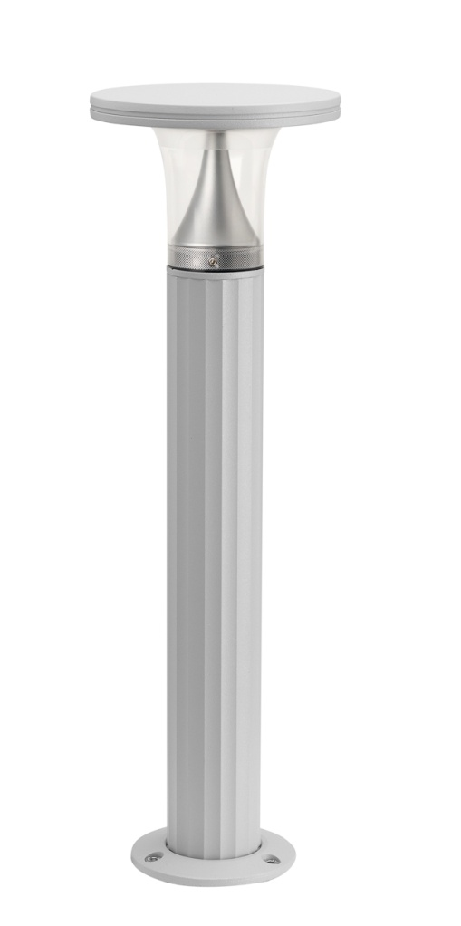
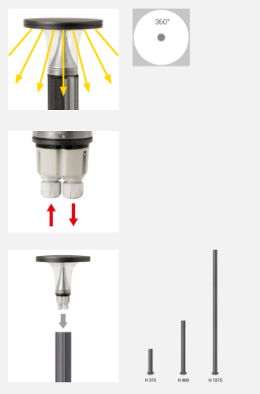
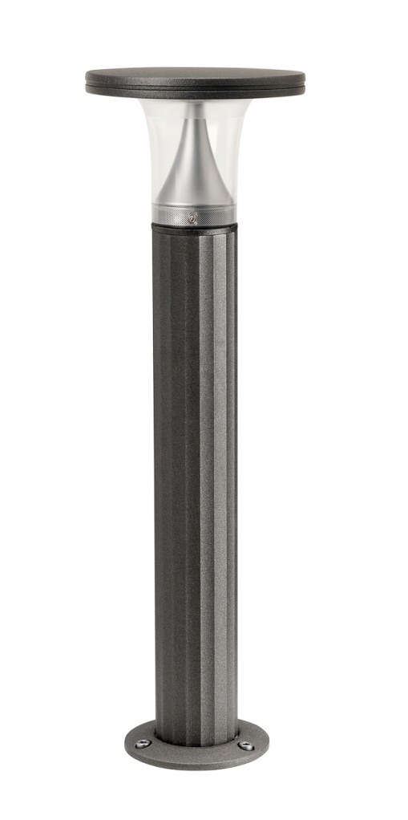
CANTHARELLUS

Slide 15
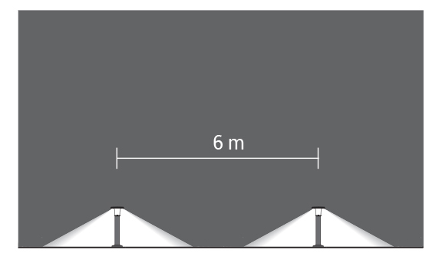
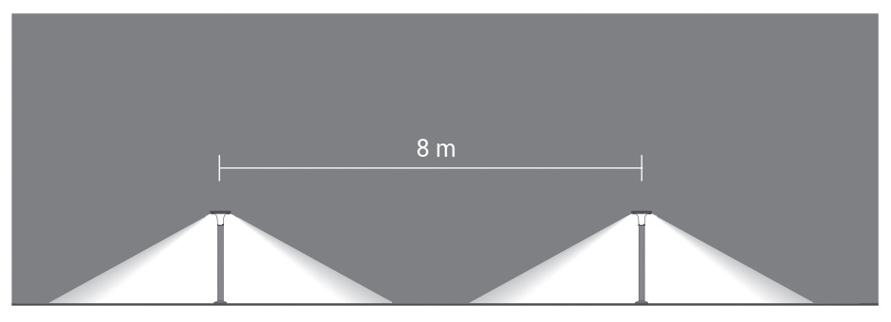
CANTHARELLUS: suggested spacing
5521 on post h375mm
5522 on post h800mm
5522 on post h1875mm

Slide 16
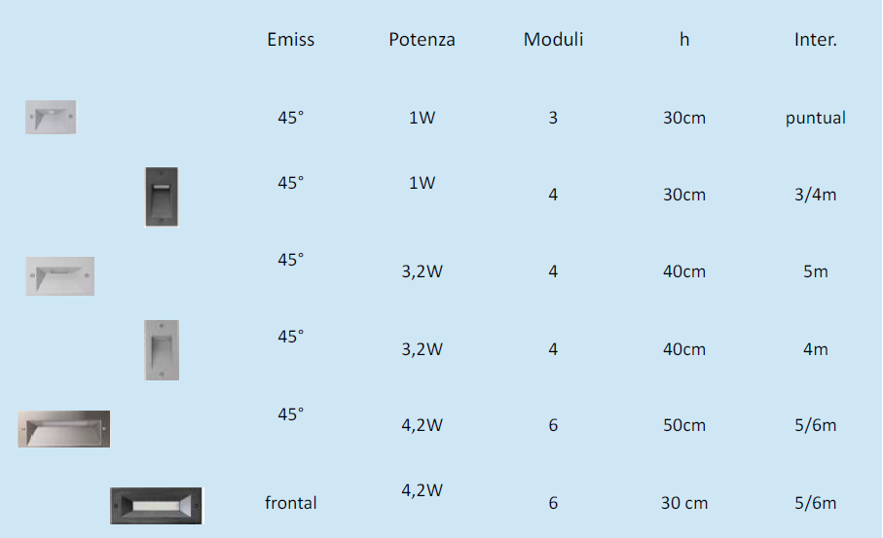
QUANTUM

Slide 17
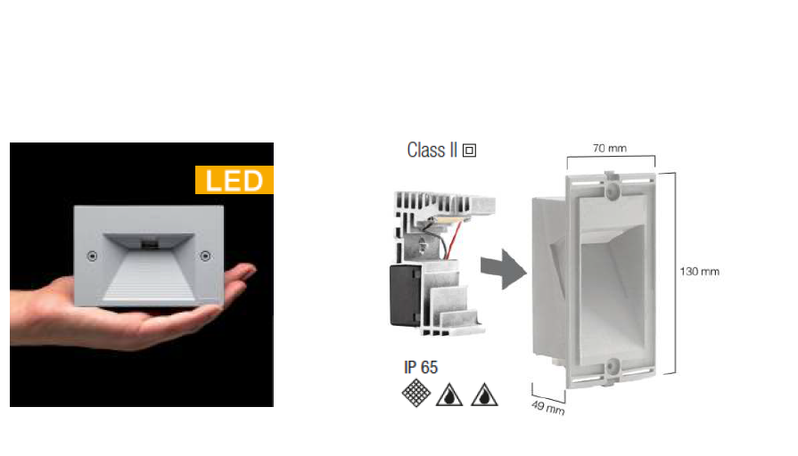
QUANTUM

Slide 18
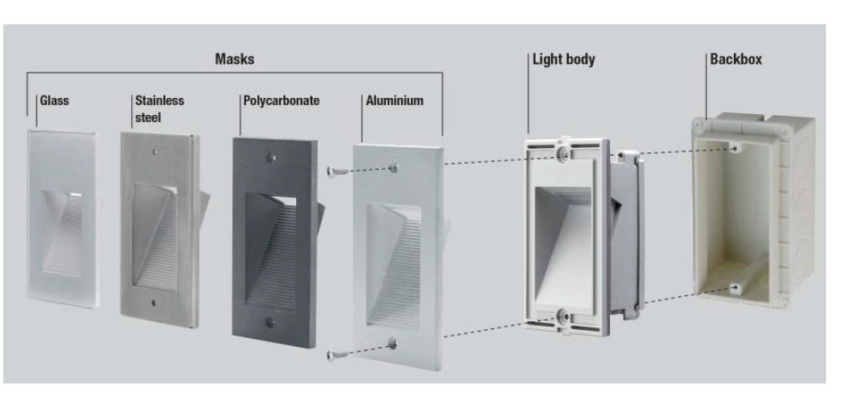
QUANTUM: FLEXIBILITY

Slide 19
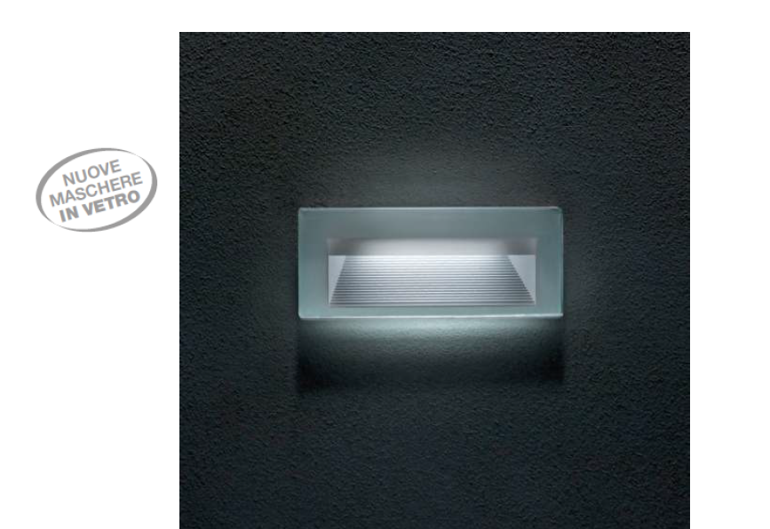
QUANTUM: Glass Mask

Slide 20
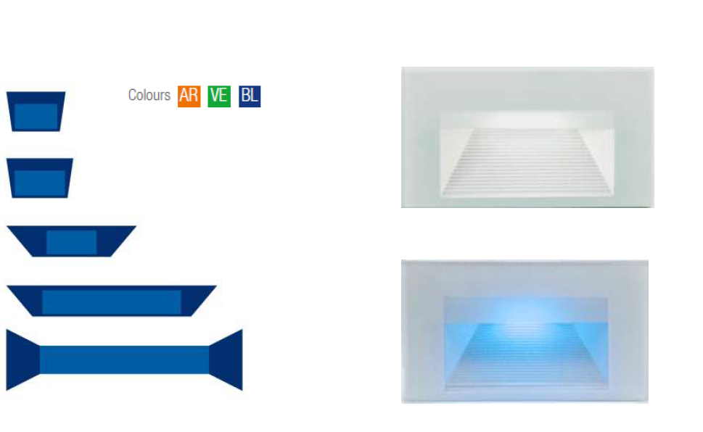
QUANTUM: LEE - FILTER

Slide 21
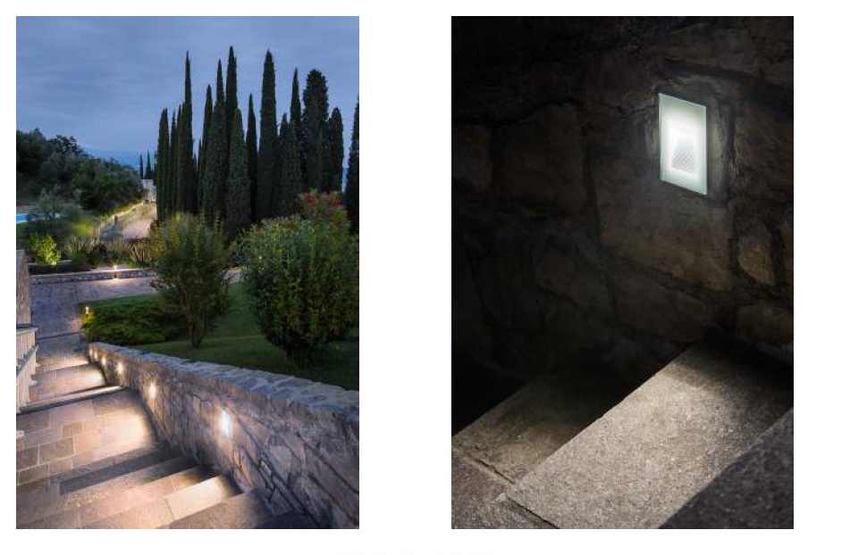
QUANTUM: Glass Mask

Slide 22
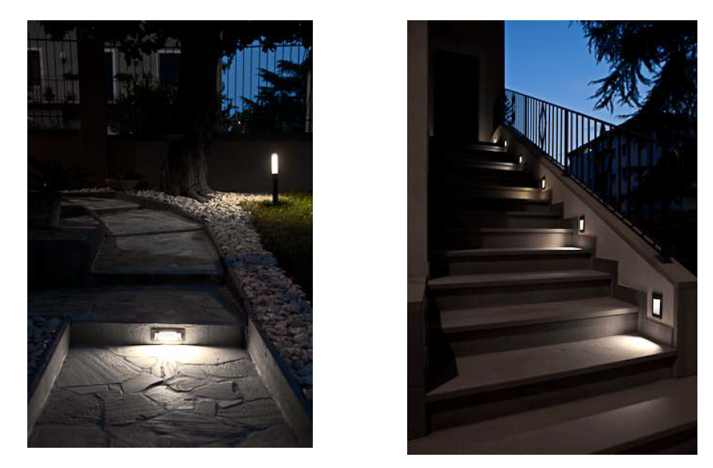
QUANTUM

Slide 23
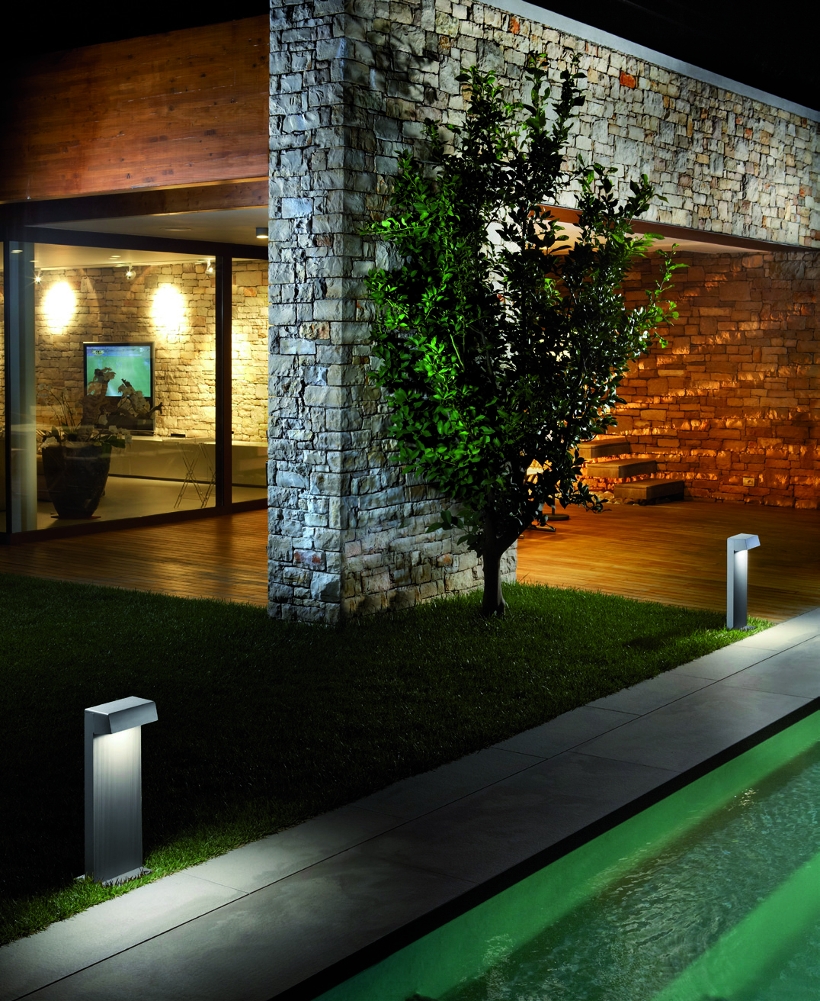
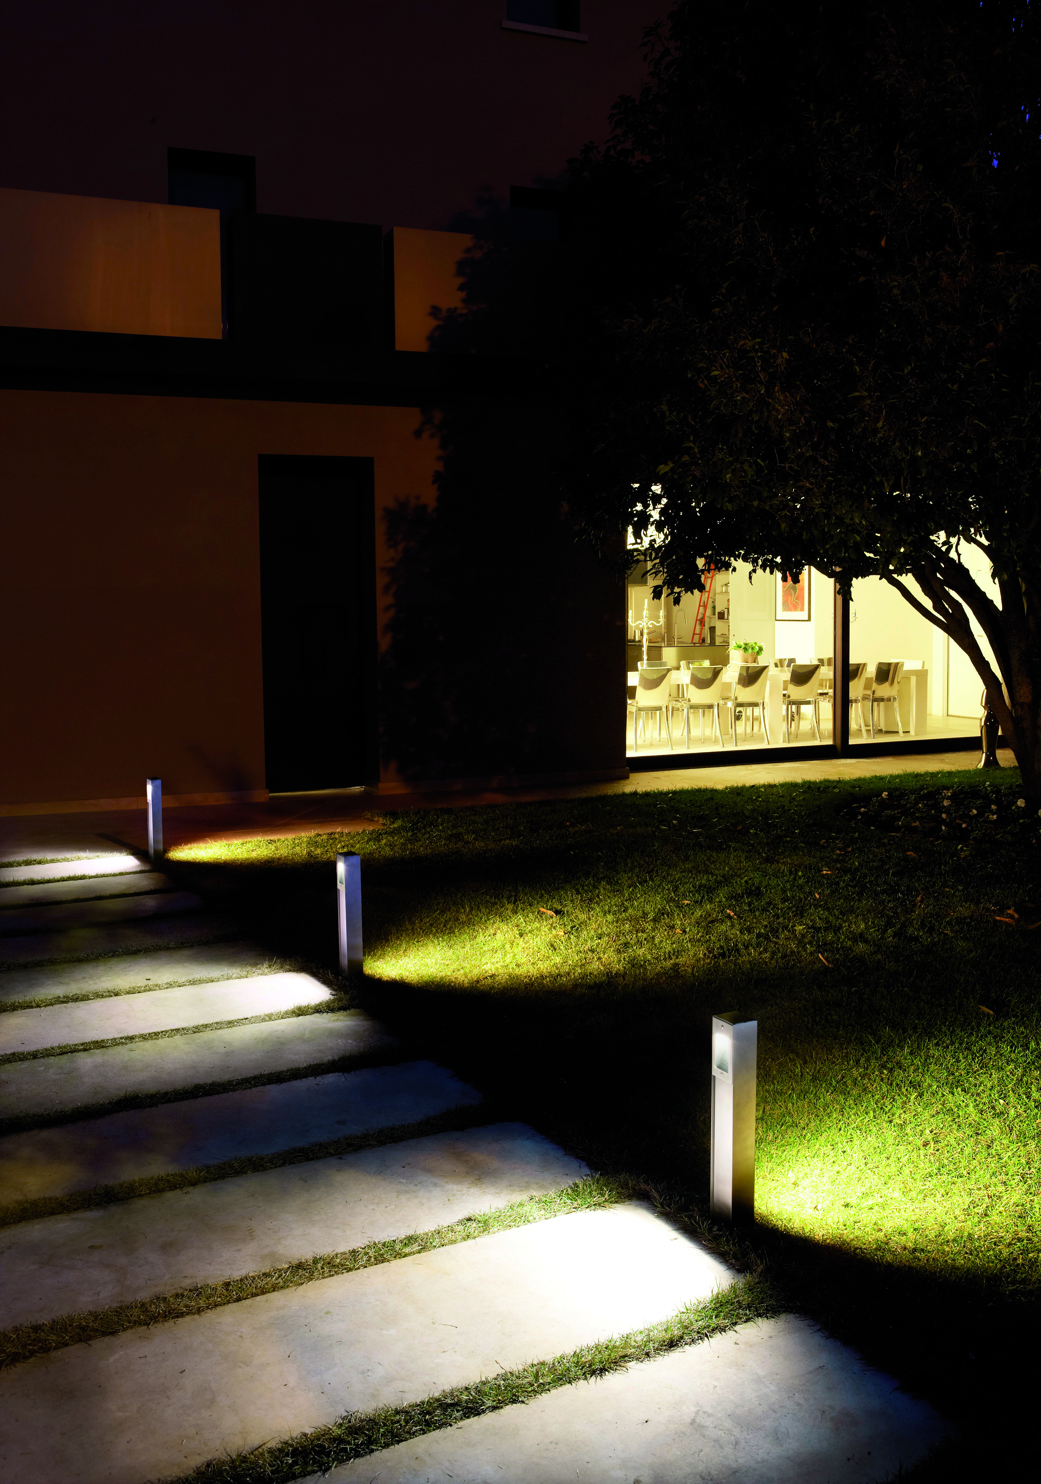
QUANTUM: Bollards 13W/3,2W

Slide 24
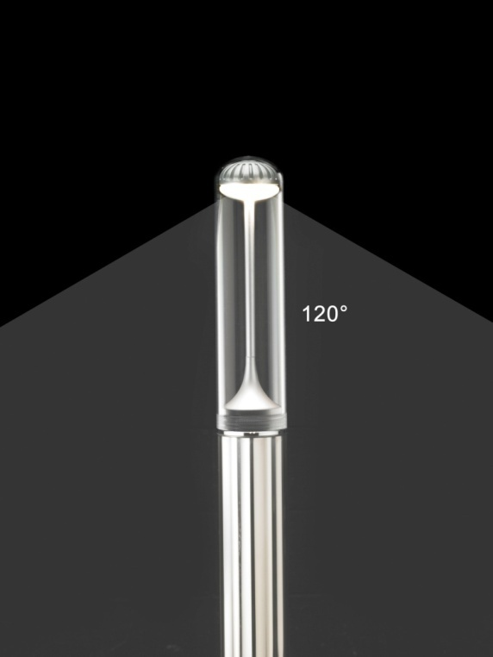
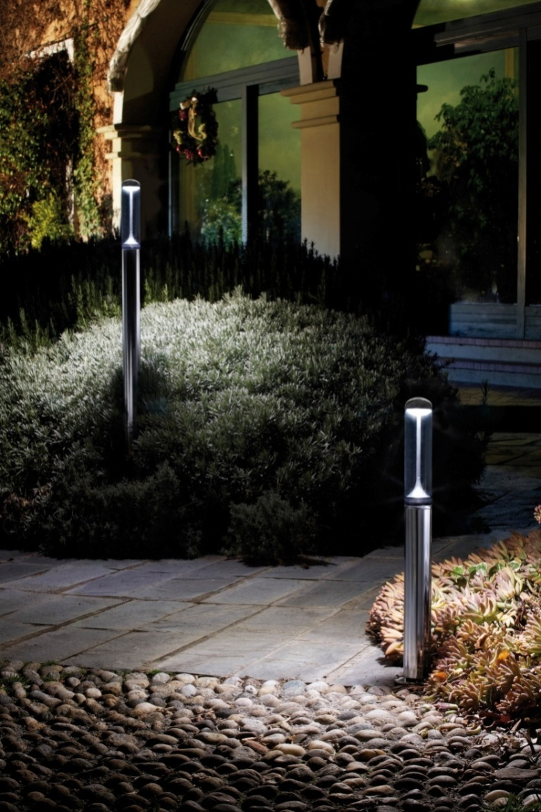
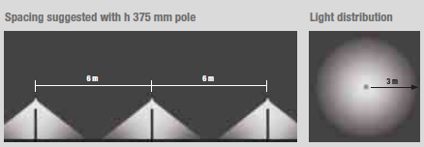
IMAGO

Slide 25
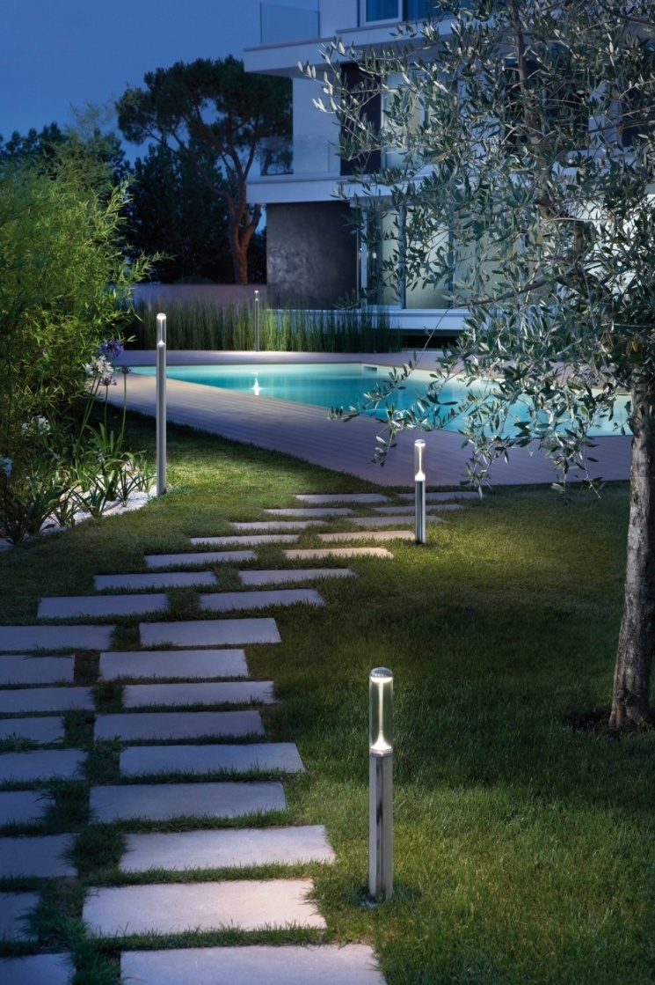
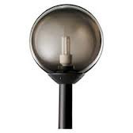
I-MAGO: Relamping sfere
Aluminium or Stainless Steel 316L
h1 = 610 mm / h2 = 1210 mm

Slide 26
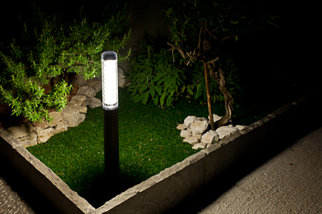
I-LUX

Slide 27
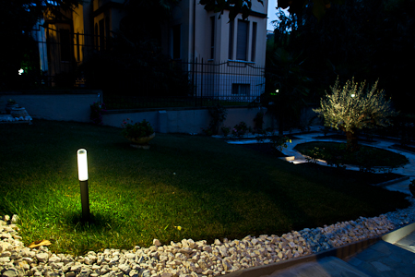
I-LUX

Slide 28
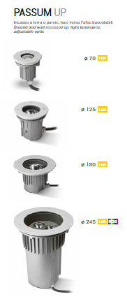
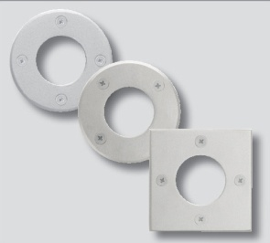
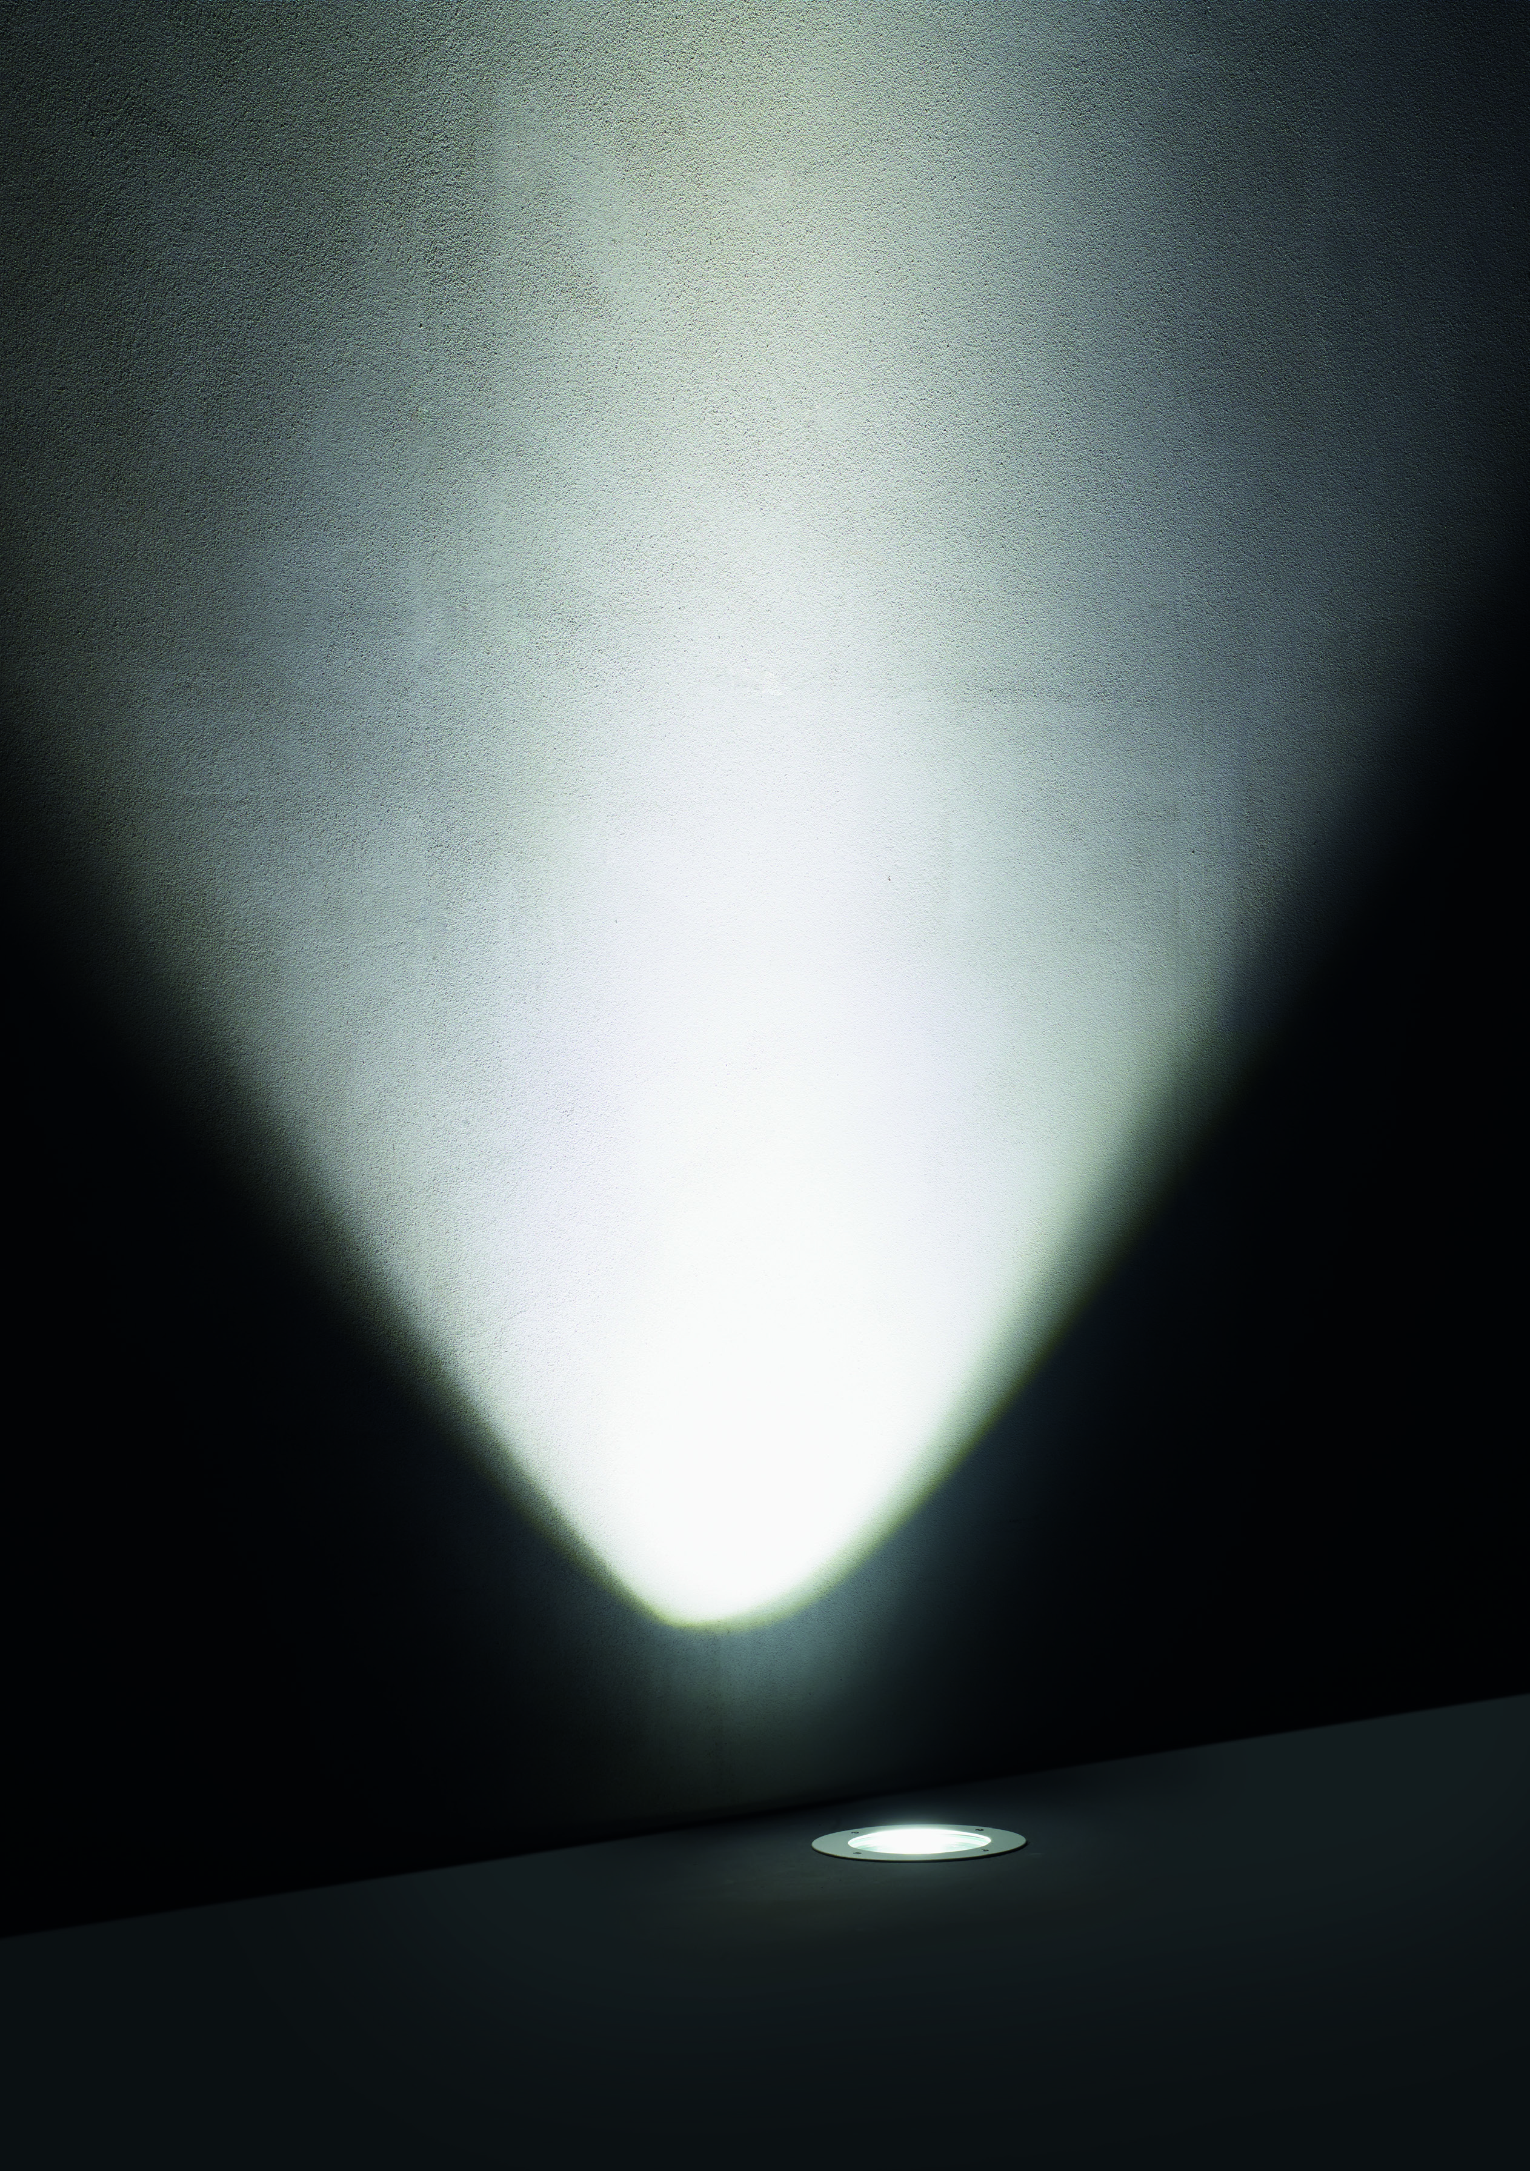
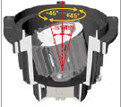
PASSUM: UPLIGHT

Slide 29
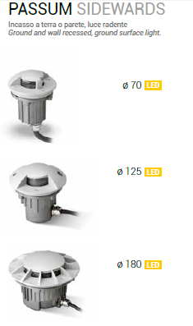
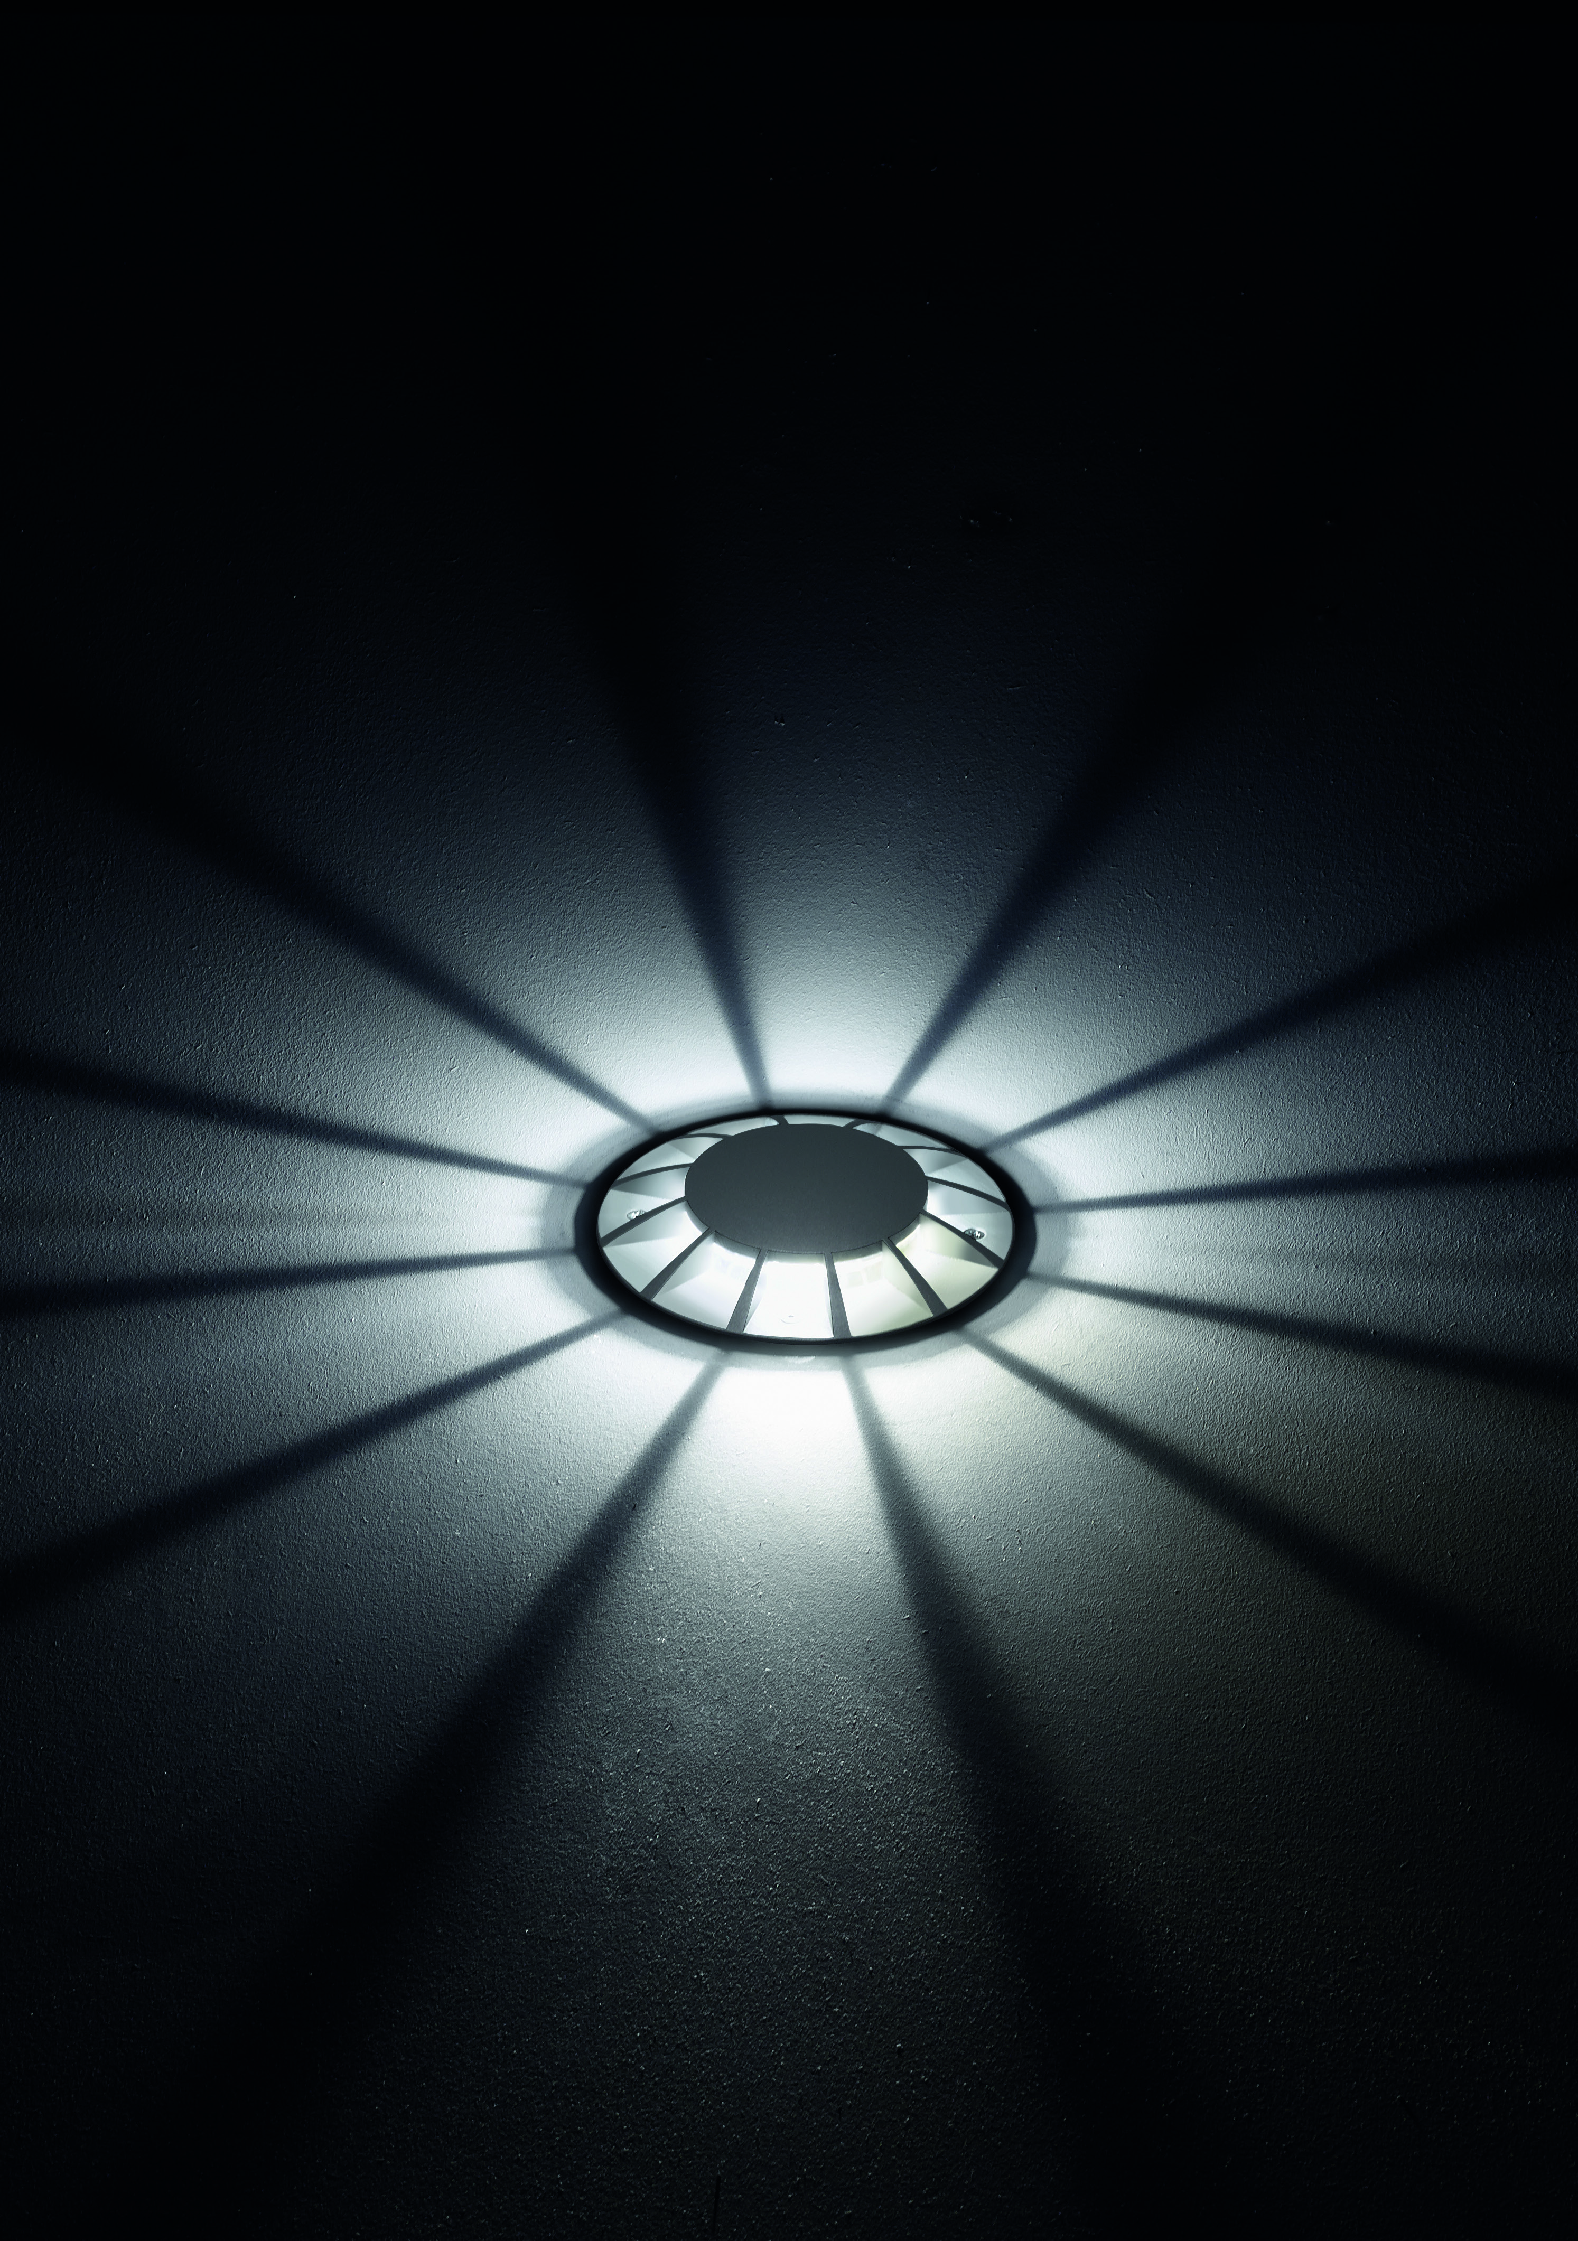
PASSUM: SIDEWARDS

Slide 30
PASSUM: ULTRAFLAT

Slide 31
WASH Rectangular

Slide 32
WASH Parabolic

Slide 33
WASH Asymmetrical

Slide 34
PASSUM IMAGES

Slide 35
LIGHTING DESIGN: LIGHTING CALCULATION

Slide 36
LIGHTING DESIGN: LIGHTING CALCULATION

Slide 37
LIGHTING DESIGN: LIGHTING CALCULATION

Slide 38
LIGHTING DESIGN : RENDER FROM PHOTOS

